Slide 1
Chapter 17: Protection

Slide 2
Chapter 17: Protection
Goals of Protection
Principles of Protection
Protection Rings
Domain of Protection

Slide 3
Goals of Protection
In one protection model, computer consists of a collection of objects, hardware or software
Each object has a unique name and can be accessed through a well-defined set of operations
Protection problem - ensure that each object is accessed correctly and only by those processes that are allowed to do so

Slide 4
Principles of Protection
Guiding principle – principle of least privilege
Programs, users and systems should be given just enough privileges to perform their tasks
Properly set permissions can limit damage if entity has a bug, gets abused
Can be static (during life of system, during life of process)
Or dynamic (changed by process as needed) – domain switching, privilege escalation
Compartmentalization a derivative concept regarding access to data
Process of protecting each individual system component through the use of specific permissions and access restrictions

Slide 5
Principles of Protection (Cont.)
Must consider “grain” aspect
Rough-grained privilege management easier, simpler, but least privilege now done in large chunks
For example, traditional Unix processes either have abilities of the associated user, or of root
Fine-grained management more complex, more overhead, but more protective
File ACL lists, RBAC
Domain can be user, process, procedure
Audit trail – recording all protection-orientated activities, important to understanding what happened, why, and catching things that shouldn’t
No single principle is a panacea for security vulnerabilities – need defense in depth

Slide 6
Protection Rings
Components ordered by amount of privilege and protected from each other
For example, the kernel is in one ring and user applications in another
This privilege separation requires hardware support
Gates used to transfer between levels, for example the syscall Intel instruction
Also traps and interrupts
Hypervisors introduced the need for yet another ring
ARMv7 processors added TrustZone(TZ) ring to protect crypto functions with access via new Secure Monitor Call (SMC) instruction
Protecting NFC secure element and crypto keys from even the kernel

Slide 7
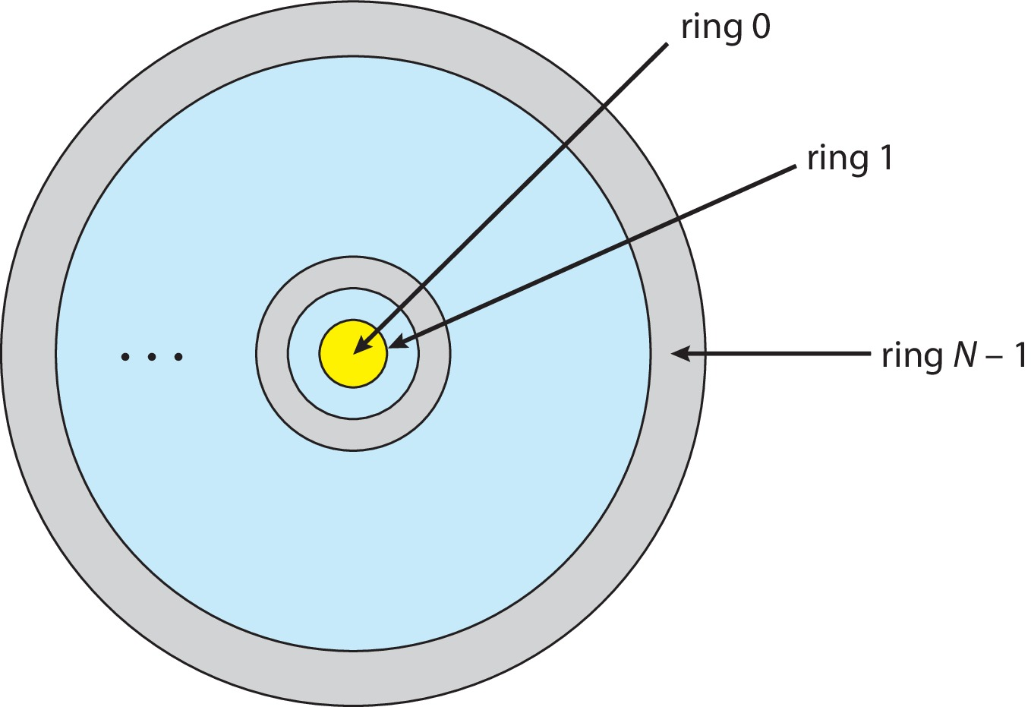
Protection Rings (MULTICS)
Let D_{i} and D_{j} be any two domain rings
If j < I ⇒ D_{i} ⊆ D_{j}

Slide 8
Domain of Protection
Rings of protection separate functions into domains and order them hierarchically
Computer can be treated as processes and objects
Hardware objects (such as devices) and software objects (such as files, programs, semaphores
Process for example should only have access to objects it currently requires to complete its task – the need-to-know principle

Slide 9
Domain of Protection (Cont.)
Implementation can be via process operating in a protection domain
Specifies resources process may access
Each domain specifies set of objects and types of operations on them
Ability to execute an operation on an object is an access right
<object-name, rights-set>
Domains may share access rights
Associations can be static or dynamic
If dynamic, processes can domain switch

Slide 10
End of Chapter 17

